Slide 1
Double SideBand Suppressed Carrier
(DSB-SC)
Signals and Communication Systems (24EC2105)

Slide 2
Double Side Band Suppressive Carrier
DSB-SC

Slide 3
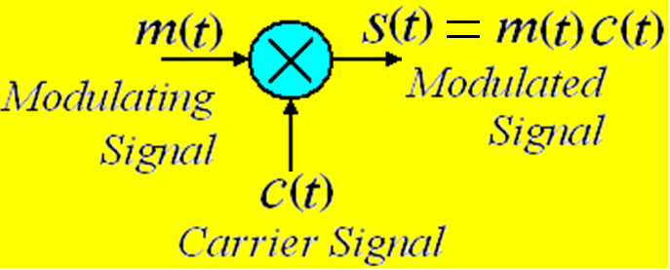
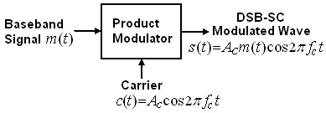
Block Schematic Diagram of DSB-SC

Slide 4
Single Tone DSB-SC Modulation
Time Domain Description: Let a message signal
Then DSB-SC signal as a function of time is represented by
Frequency Domain Description:

Slide 5
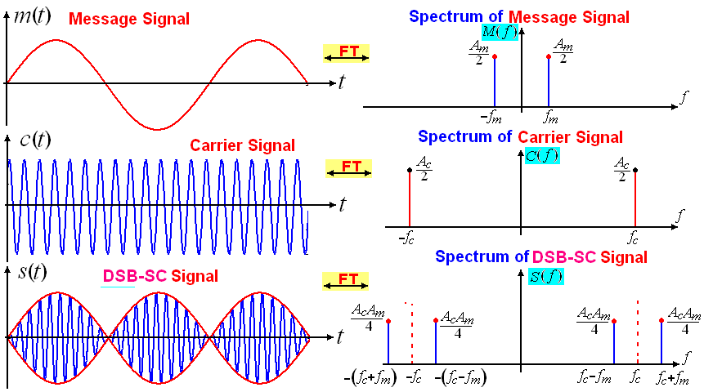
Single Tone DSB-SC Modulation and its Spectrum
s(t) undergoes a phase reversal whenever m(t) crosses zero

Slide 6
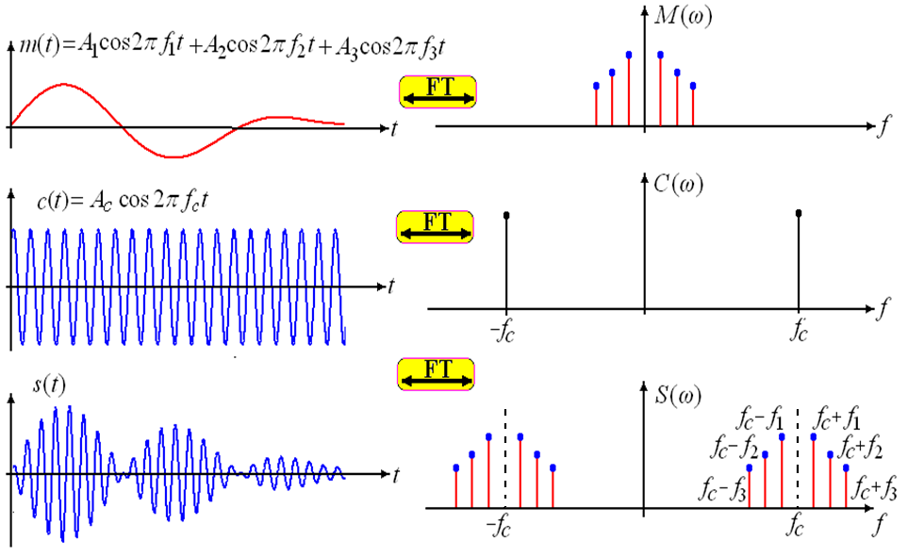
Multi Tone DSB-SC Modulation

Slide 7
Baseband Signal DSB-SC Modulation
Let the message signal is assumed to be band limited to ‘W’ Hz.
Time Domain Description:
The standard form of a DSB-SC modulated signal as a function of time is represented by
Frequency Domain Description

Slide 8
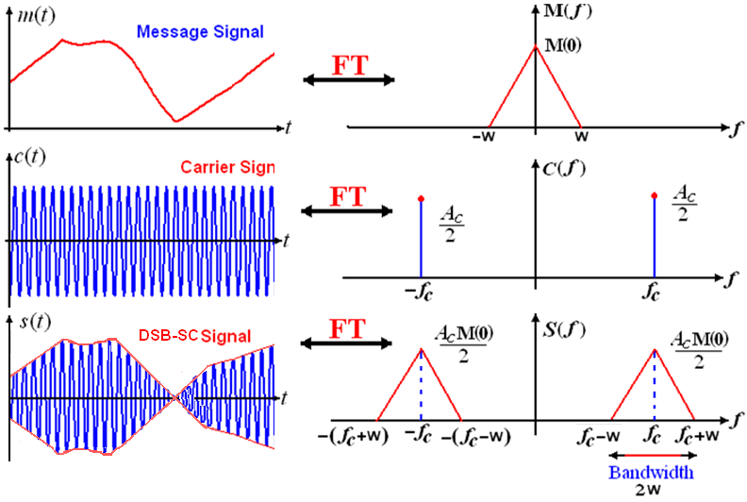
Baseband DSB-SC Spectrum
z
Transmission Bandwidth of DSB-SC is 2 W Hz

Slide 9
Main Points of DSB-SC
The Carrier power is eliminated, so that efficiency increased in compare with standard AM.
But the Transmission Bandwidth is same as standard AM, that is two times of message signal bandwidth.
The phase of DSB-SC modulated signal is phase reversed when the modulating signal m(t) crosses zero .
Coherent detection is needed for DSB-SC: Obtaining the carrier phase is biggest challenges in all demodulators.

Slide 10
End

